Slide 1
GanaSalesLite
Web-Based Sales and Customer Management System
Presented By: Pranish Siris and Bishal Somare

Slide 2
Acknowledgement
This project, "GanaSalesLite" has been an invaluable journey, allowing us to delve into the depths of our knowledge and skills. We extend our heartfelt gratitude to our project supervisor, Mr. Suraj Khatri, and the Faculty of Management, Tribhuvan University, for exceptional guidance, supervision, and invaluable insights that were instrumental in the successful completion of this project.

Slide 3
Introduction
GanaSalesLite
A pioneering web-based Sales and Customer Management System designed to redefine business operations at Ganapati Enterprise. From intuitive product management to real-time sales tracking and seamless customer relationship management.

Slide 4
Company Background
Ganapati Enterprise operates as a wholesale distributor, facilitating the flow of cosmetic products from vendor to retailers through reliable distribution services.
Company Type: Small Enterprise Location: Devdaha, Rupandehi Business Focus: Cosmetics Products Distribution Managed By: Single Entrepreneur (Owner)

Slide 5
Problem Statement
Inefficient Data Management
Time-Consuming Sales Process
Lack of Real-Time Inventory Overview
Difficulty in Generating Reports
No Centralized System
Notes:
Manual tracking in ledgers prone to human error
Manual billing and inventory updates
Difficulty tracking current stock levels accurately
Extracting insights from manual records
Information scattered across physical books

Slide 6
Objectives
Simplify daily business operations
Provide centralized platform
Assist in informed decision-making
Ensure ease of use and accuracy
Notes:
by automating sales, customer, and product management tasks
for managing reliable business information
through dashboards, reports, and stock alerts
making the system accessible to non-technical users

Slide 7
Functionalities
Admin must securely log in and log out with access restricted to authorized users.
Admin must be able to add, update, delete, and view products along with their categories.
Admin must be able to manage customer details, including adding and updating information.
Admin must be able to record sales with multiple items, and the system must automatically calculate the total and generate printable bills.
The system must update inventory levels after each sale and alert for low or expired stock.
Notes:
Secure login and logout system
Add, update, delete, and view products with categories
Manage customer details and information
Record sales transactions and generate printable bills
Auto-update stock levels and low stock alerts
Generate sales reports and dashboard summaries

Slide 8
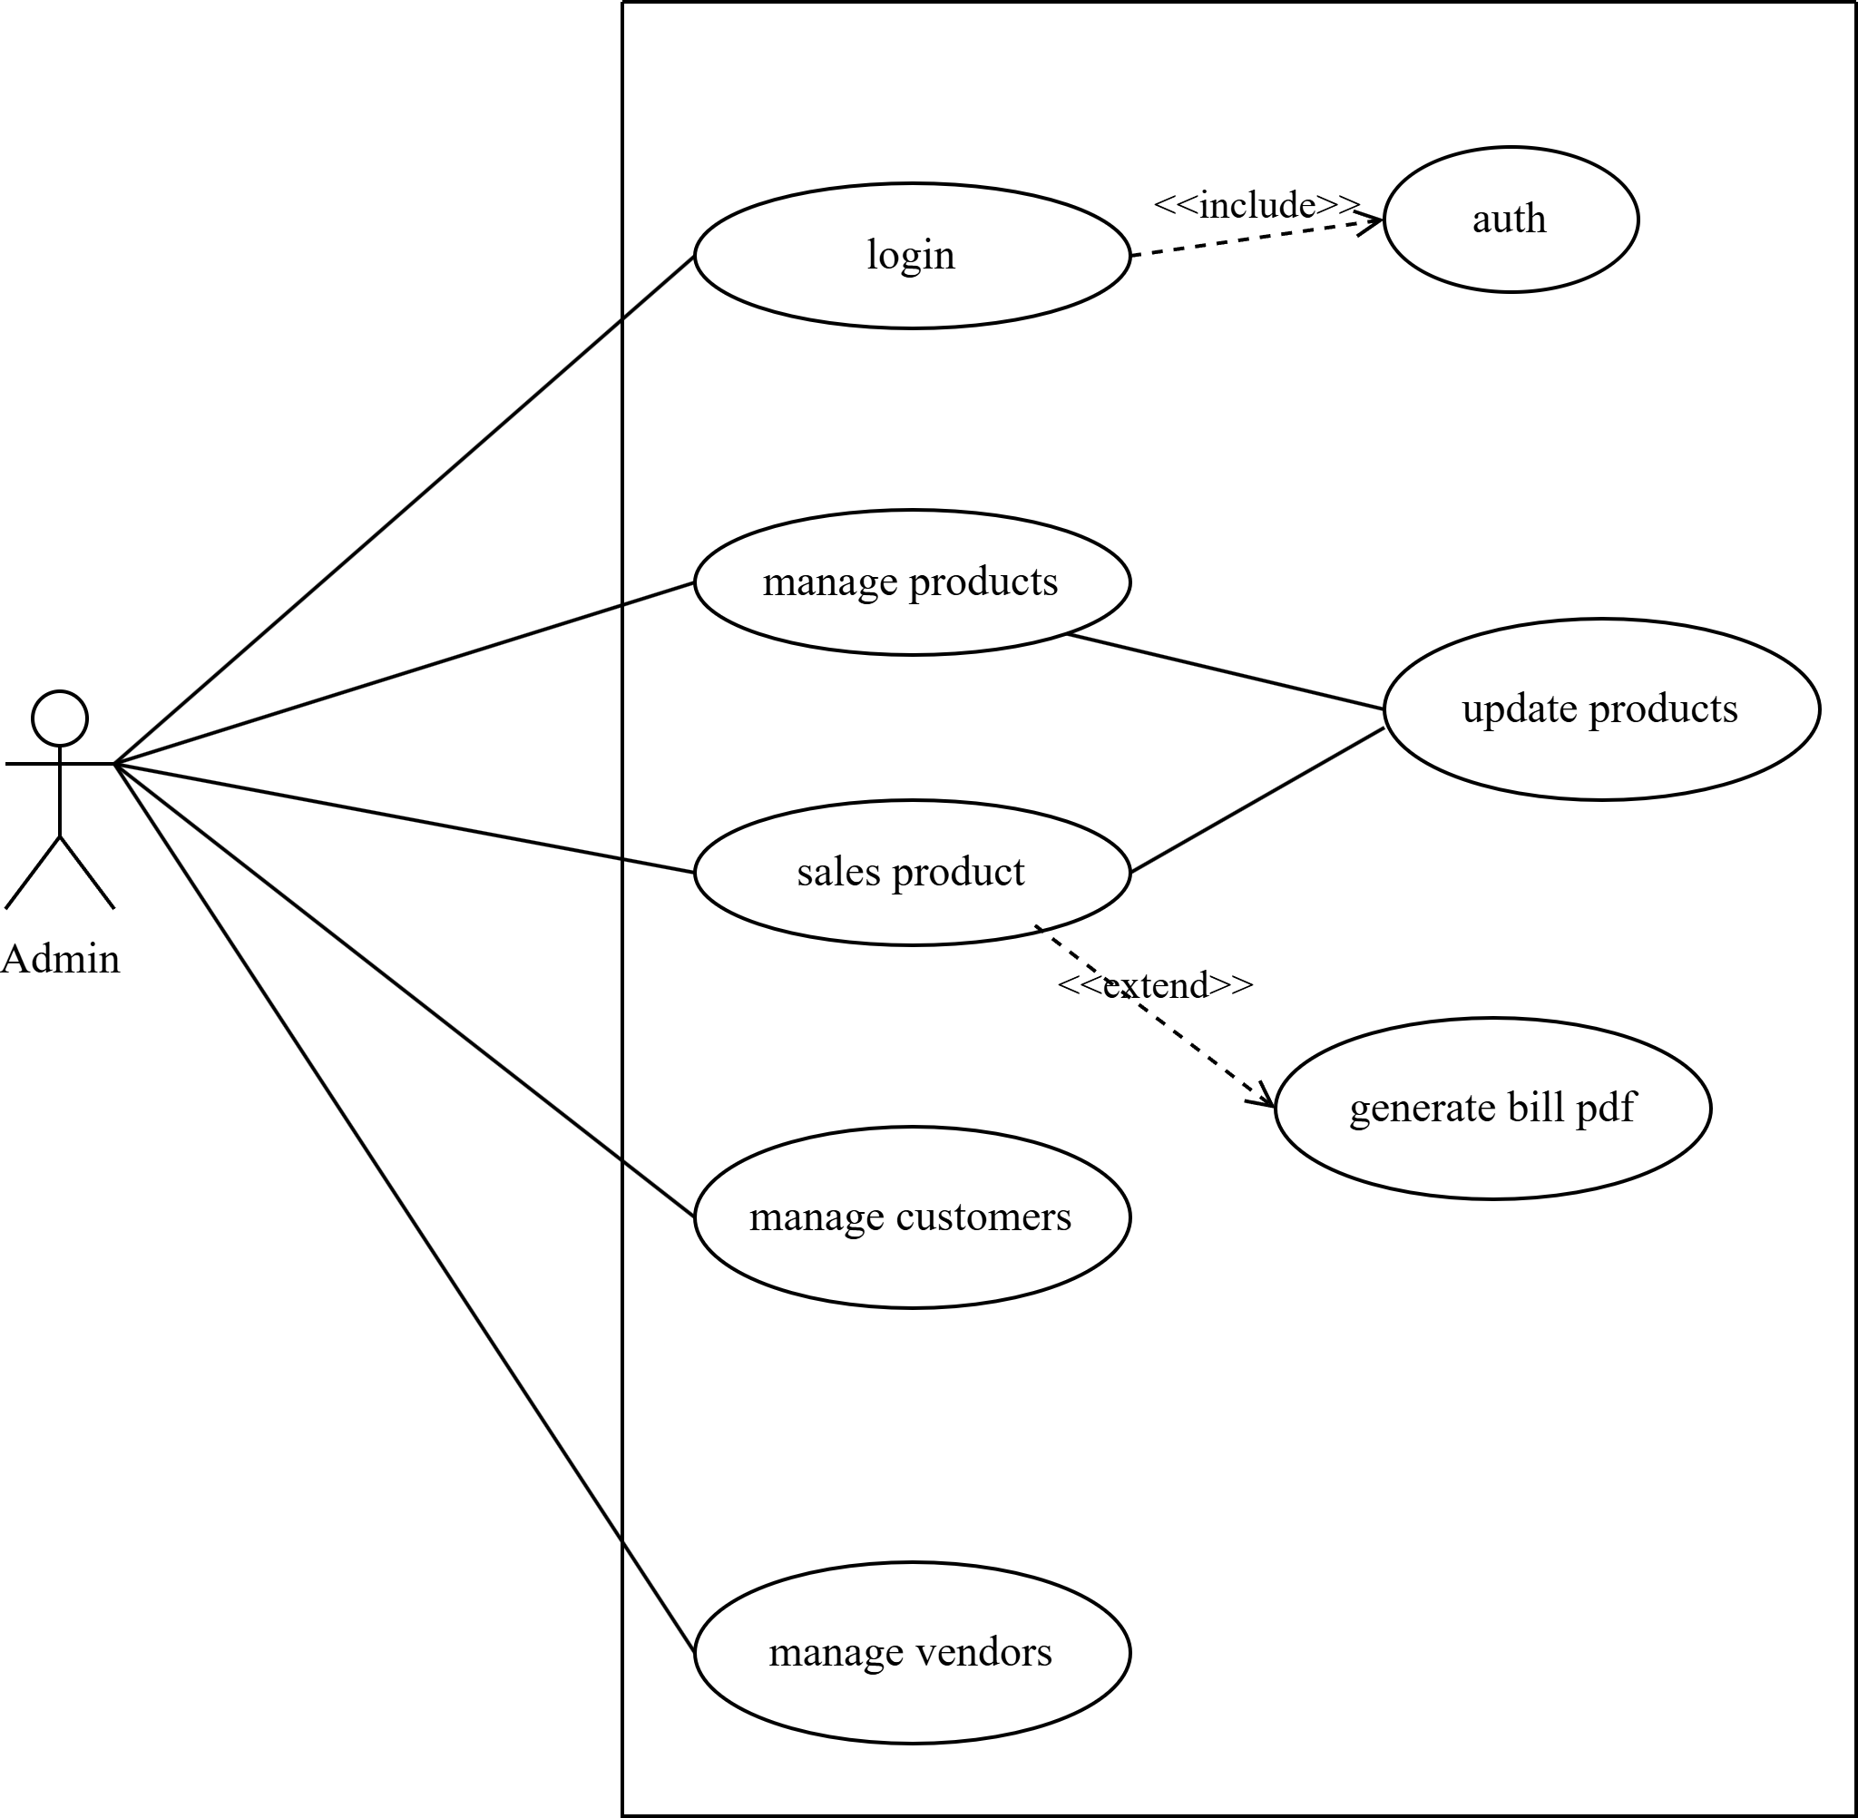
Use Case Diagram
The use case diagram represents the role of Admin in "GanaSalesLite" system interactions.

Slide 9
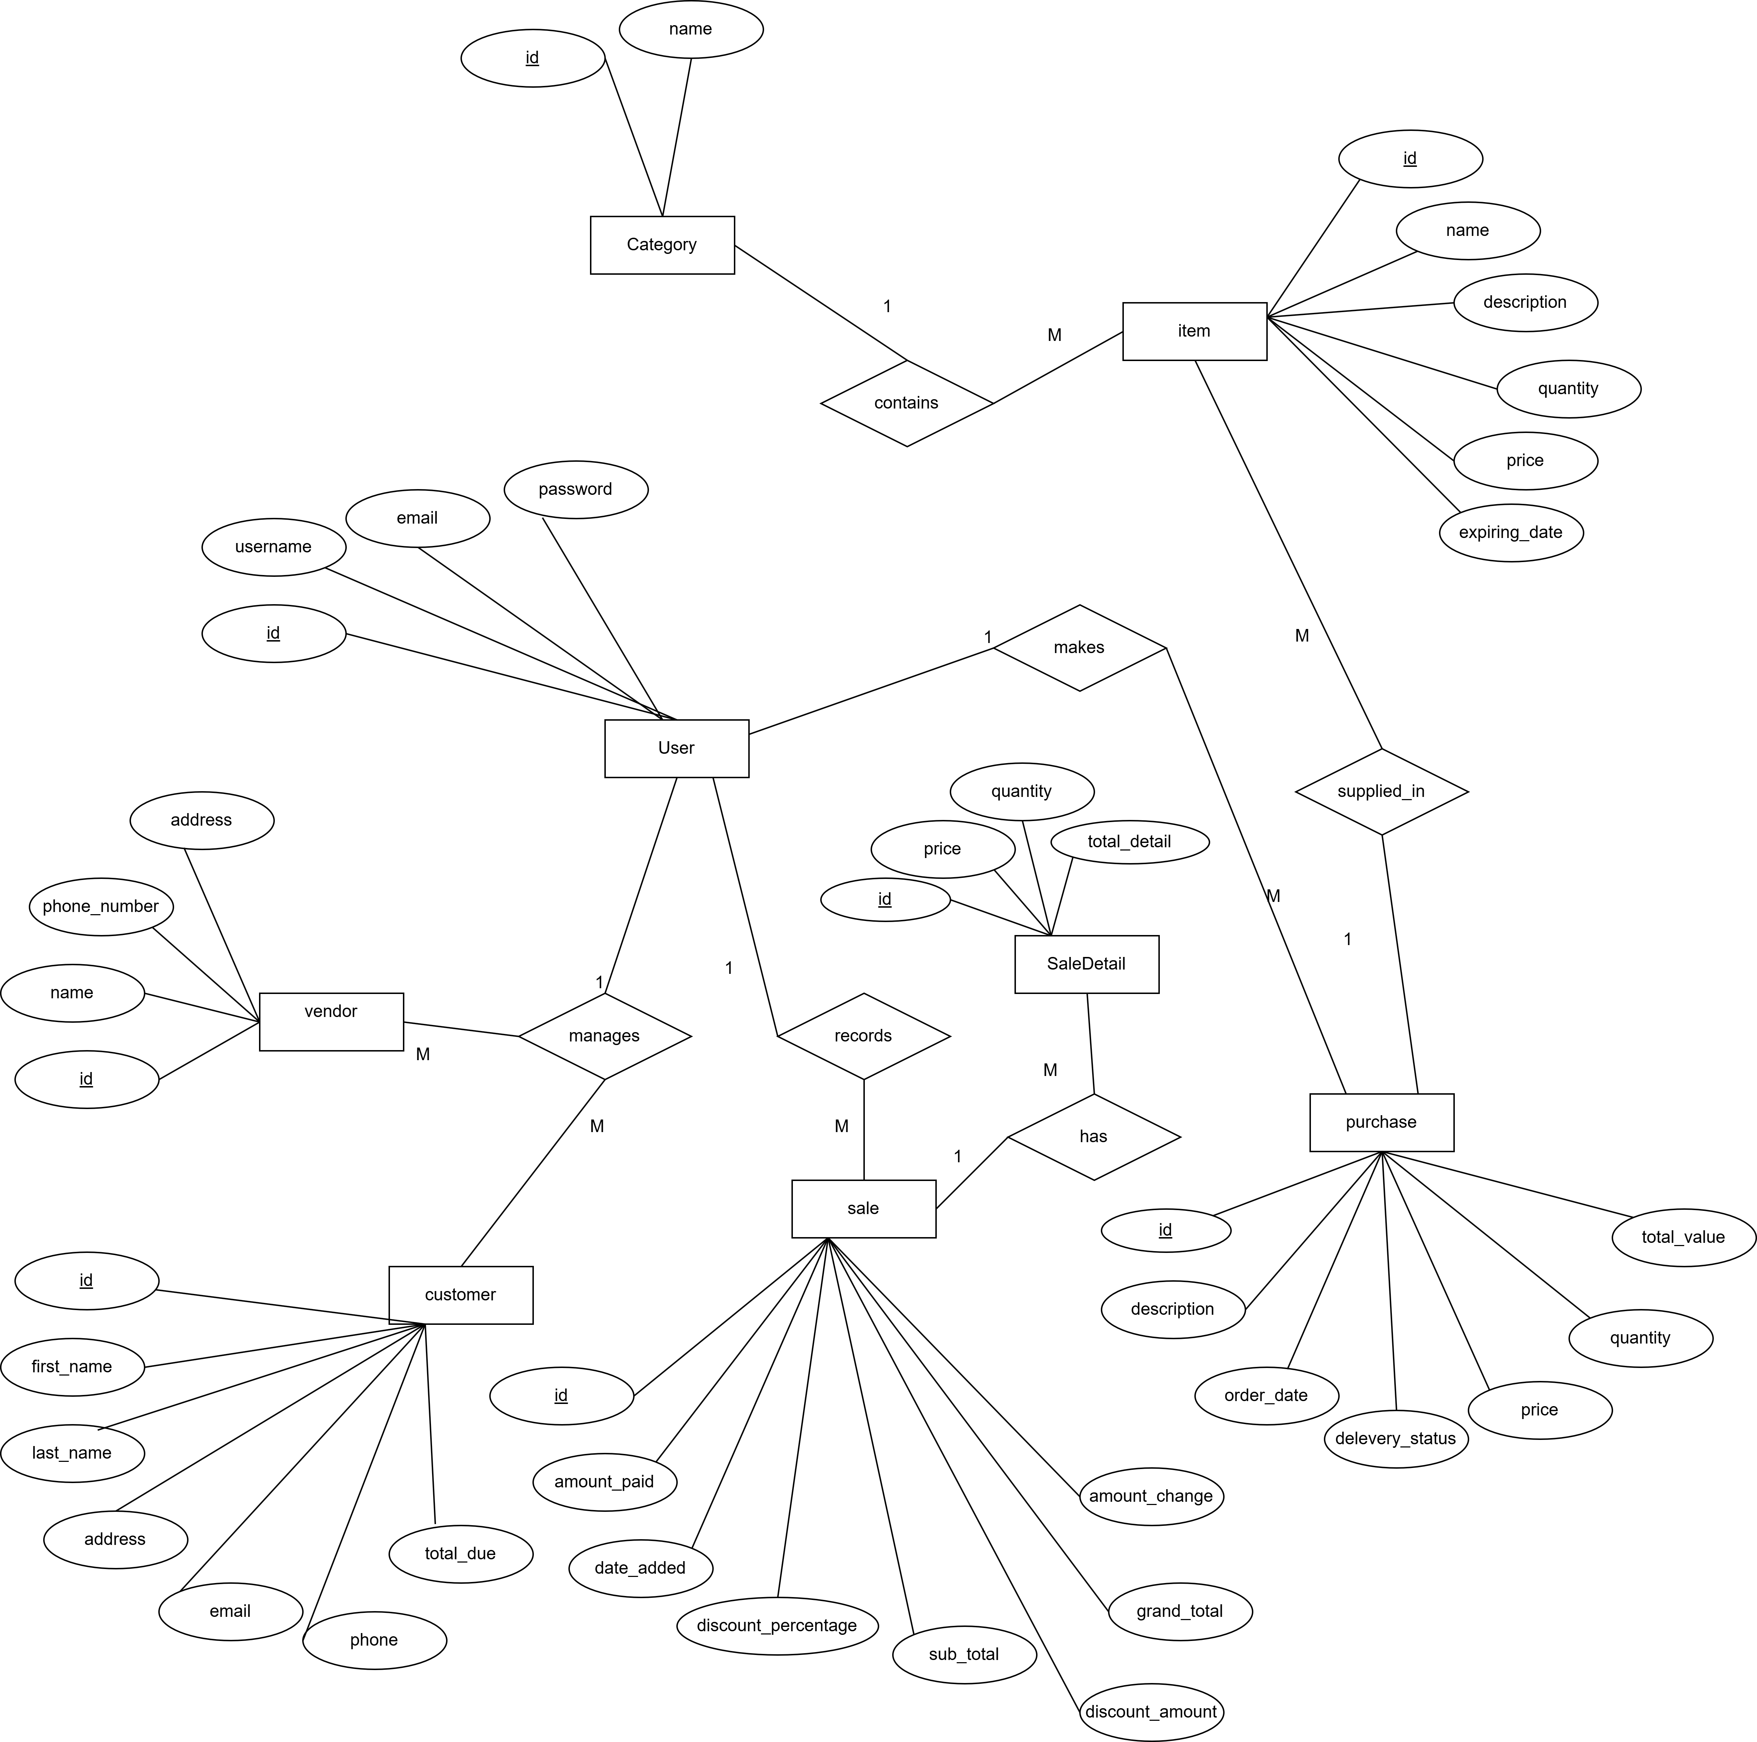
Entity Relational Diagram
This diagram serves as a visual representation of how entities such as admin, products, customers, and sales relate to each other within "GanaSalesLite".
Ultimately, the ERD plays a crucial role in designing and implementing the database schema for "GanaSalesLite" ensuring efficient data management and seamless user experiences.

Slide 10
List of Entity
User
Item
Customer
Sale
Category
Vendors
Purchase
Saledetail

Slide 11
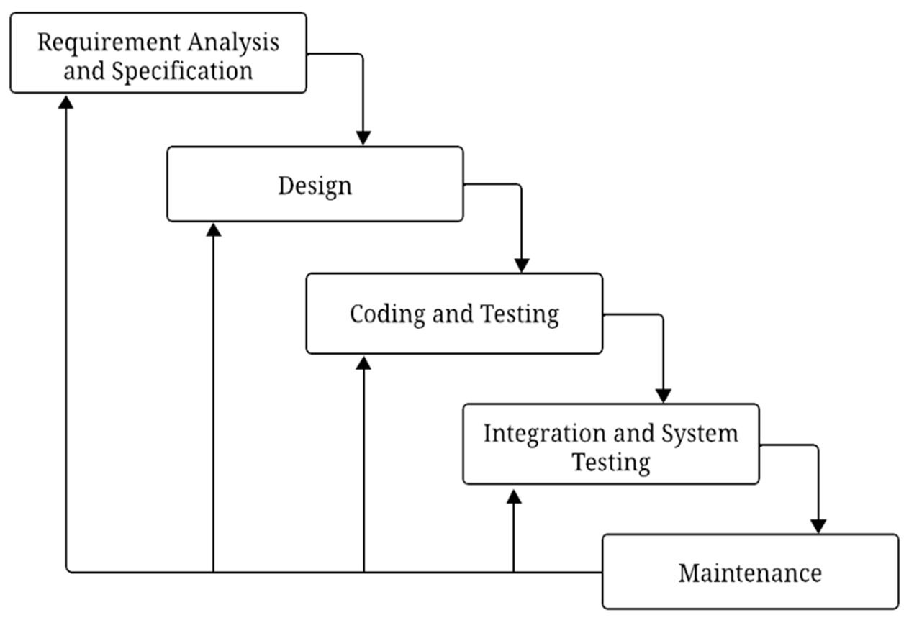
Software Development Model
"GanaSalesLite" adopts an iterative waterfall software development model, encompassing key phases to ensure a robust and efficient sales management solution.

Slide 12
Outcome of GanaSalesLite
Enhanced Operational Efficiency
Streamlined Sales Management
Centralized Data Repository
Simplified Inventory Management
Notes:
Real-time insights into sales and inventory
Automated billing and transaction processing
Single source of truth for business information
Automatic stock updates and alerts

Slide 13
Tools & Technologies
Design Tools: Draw.io for diagram design
Development Stack:
Backend: Python with Django framework
Database: PostgreSQL
Frontend: HTML5, CSS3, JavaScript, Bootstrap,Ajax
Development Environment: Visual Studio Code
Version Control: Git & GitHub
Documentation: Microsoft Word

Slide 14


